Slide 1


Deciding Between the ACT and the SAT:
Can State- and College-Level Data Help?
analysis by Loren Dunn
Photos from: https://www.greatschools.org/gk/wp-content/uploads/2016/06/New-SAT-testing.jpg;
https://www.iii.org/article/do-i-need-insurance-child-going-away-college

Slide 2
The Answer:
Yes, it appears state- and college-level data can provide helpful guidance for students deciding between the ACT and the SAT.

Slide 3
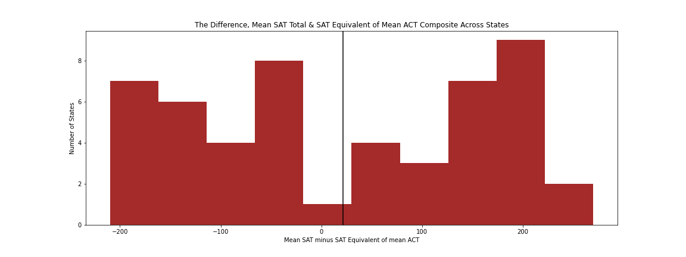
When converted to an equivalent SAT score,
the mean ACT Composite can vary by over 200 points from the mean SAT Total Score

Slide 4
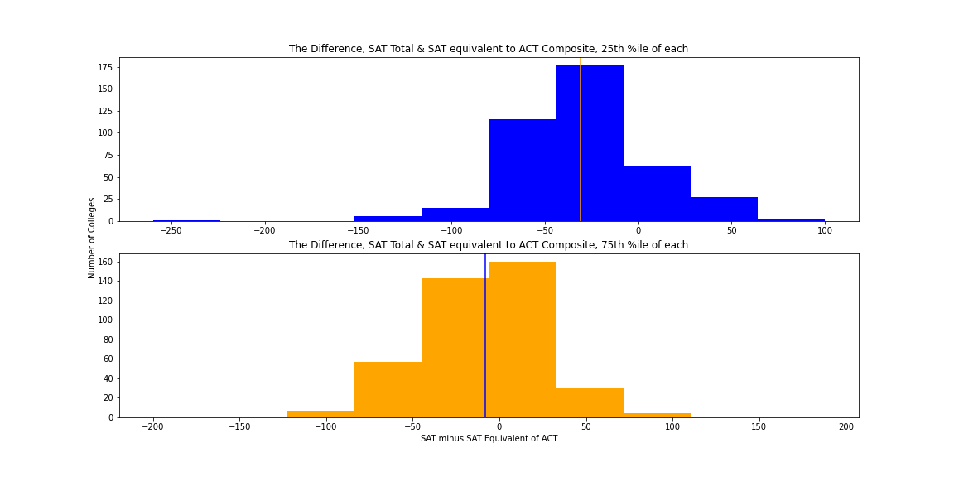
This pattern is less pronounced when looking at college-level data at the 25th and 75th percentiles, but there are still meaningful variations, especially at the 75th percentile.

Slide 5
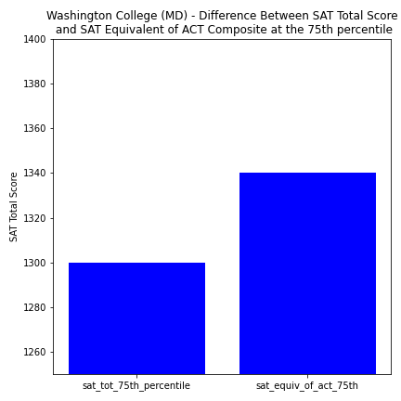
Applicants are being compared to each other…
…so a student can can gain an
advantage by using the “weaker test”.
Example:
Among Washington College (MD) applicants:
- the ACT equivalent of a 1340 is the 75th percentile
- an actual SAT 1340 would be above the 75th percentile among their applicants
Notes:
A 1300 is equivalent to a 28
At Washington College (MD), in 2019:
75th percentile SAT was 1300
75th percentile ACT was a 29
ACT 29 is equivalent to an SAT 1340
the 1300 SAT student appears equally strong as the “1340” ACT student, relative to admitted peers

Slide 6
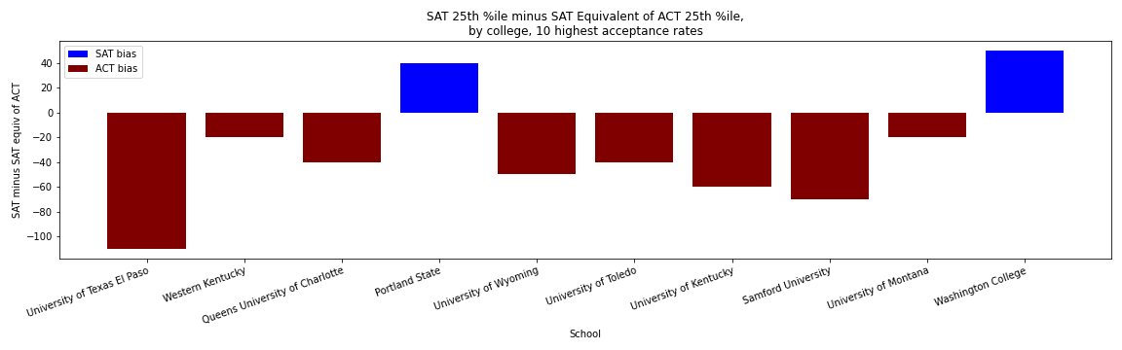
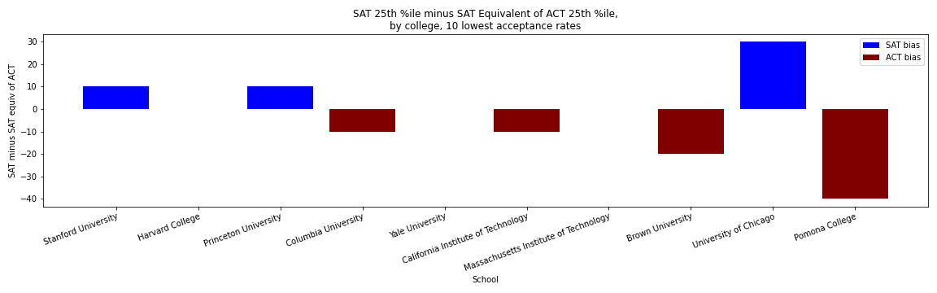
25th Percentile, 10 Highest, 10 Lowest Acceptance Rates

Slide 7
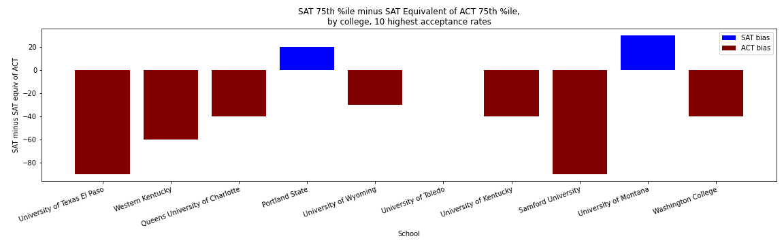
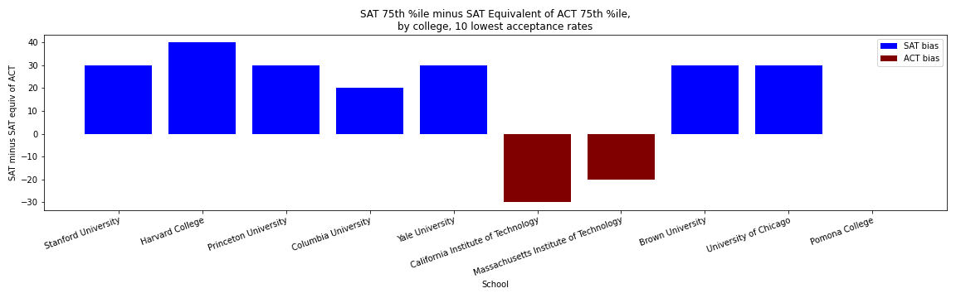
75th Percentile, 10 Highest, 10 Lowest Acceptance Rates

Slide 8
Conclusion:
Applicants may be able to get an advantage over competitors from their geographic region and at the colleges they’re applying to by selecting their test accordingly.
With more data, we could build a tool to advise students internally, or to build brand recognition by making it available publicly.
Notes:
Factors to be considered include: geography, college, and where the student’s scores fall among the college’s applicants

Slide 9
Additional information to seek:
how much can 30 total points on the SAT or 1 composite point on the ACT benefit a student? In what situations?
at what level of geography are colleges focused?
What data is available about the student’s high school’s SAT/ACT scores?
Can we get college data on successful applicants states/regions to compare?

